Slide 1
ALGEBRA LINEAL
José Andrés Munguía Cortez

Slide 2
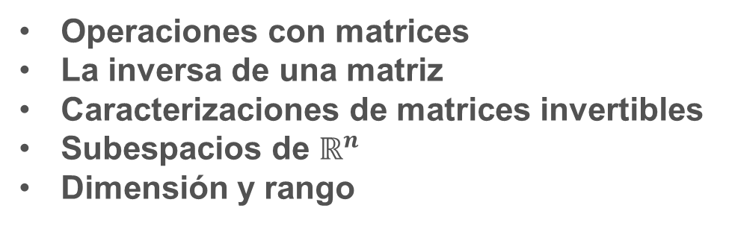
UNIDAD II ALGEBRA DE MATRICES Y DETERMINANTES
Temas:
Operaciones con matrices
La inversa de una matriz
Caracterizaciones de matrices invertibles
Subespacios de $ℝ^{n}$
Dimensión y rango
Resultado de aprendizaje:
Aplica operaciones con matrices y el cálculo de determinantes para la resolución de problemas en contextos matemáticos e ingenieriles.

Slide 3






Inversa de una matriz
Se dice que la matriz $A$ $nxn$ es invertible si hay una matriz $C$ $nxn$ tal que $CA=I$ y $AC=I$, donde $I=I_{n}$. La matriz de identidad $nxn$.
Una matriz que no es singular se denomina matriz singular, y una matriz invertible se llama matriz no singular.
Ejemplo.
Si $A=\left[\begin{matrix}2 & 5 \\ −3 & −7\end{matrix}\right]$ y $C=\left[\begin{matrix}−7 & −5 \\ 3 & 2\end{matrix}\right]$
Solución.
$AC=\left[\begin{matrix}2 & 5 \\ −3 & −7\end{matrix}\right]$ $\left[\begin{matrix}−7 & −5 \\ 3 & 2\end{matrix}\right]=$
$$\left[\begin{matrix}1 & 0 \\ 0 & 1\end{matrix}\right]$$
y
$CA=\left[\begin{matrix}−7 & −5 \\ 3 & 2\end{matrix}\right]\left[\begin{matrix}2 & 5 \\ −3 & −7\end{matrix}\right]$ $=$
$$\left[\begin{matrix}1 & 0 \\ 0 & 1\end{matrix}\right]$$
Entonces, $C=A^{−1}$

Slide 4
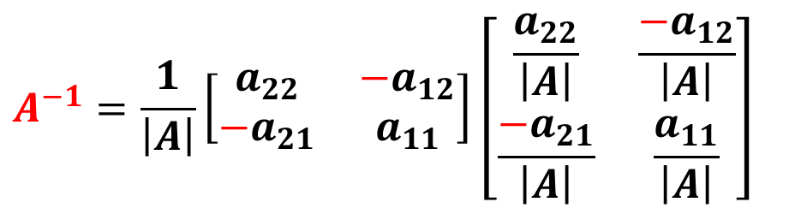
  Inversa de una matriz de orden 2X2
  Sea $A=\left[\begin{matrix}a_{11} & a_{12} \\ a_{21} & a_{22}\end{matrix}\right]$, una matriz $2x2$ para la cual el determinante $\left|A\right|≠0$, entonces la inversa de A denotada por $A^{−1}$ estará dada por:
  $$A^{−1}=\frac{1}{\left|A\right|}\left[\begin{matrix}a_{22} & {−a}_{12} \\ {−a}_{21} & a_{11}\end{matrix}\right]\left[\begin{matrix}\frac{a_{22}}{\left|A\right|} & \frac{{−a}_{12}}{\left|A\right|} \\ \frac{{−a}_{21}}{\left|A\right|} & \frac{a_{11}}{\left|A\right|}\end{matrix}\right]$$
  Lo cual podemos resumir en los siguientes 4 pasos:
  Calculamos el determinante de la matriz para determinar si tiene inversa, si es así.
  Intercambiamos de posición los elementos en la diagonal principal.
  Cambiamos el signo de los elementos en la diagonal secundaria.
  Dividimos todos los elementos de la matriz entre el valor del determinante.

Slide 5

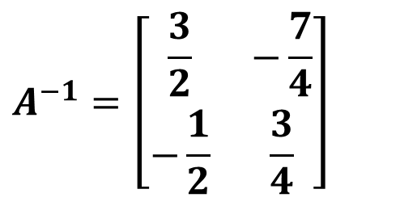
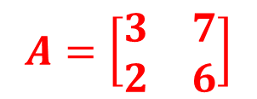
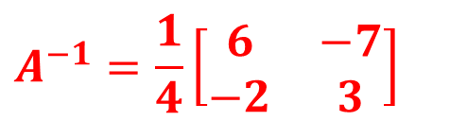


  Ejemplo
  Determine la inversa de la matriz, si existe.
  $$A=\left[\begin{matrix}3 & 7 \\ 2 & 6\end{matrix}\right]$$
  Solución
  El determinante de A
  $$\left|A\right|=\left(3\right)\left(6\right)−(2)(7)$$
  $$=18−14$$
  $$\left|A\right|=4$$
  $$A^{−1}=\left[\begin{matrix}\frac{3}{2} & −\frac{7}{4} \\ −\frac{1}{2} & \frac{3}{4}\end{matrix}\right]$$
  $$A^{−1}=\frac{1}{4}\left[\begin{matrix}6 & −7 \\ −2 & 3\end{matrix}\right]$$
  Lo que nos indica que la matriz posee inversa

Slide 6
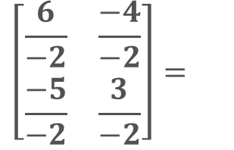
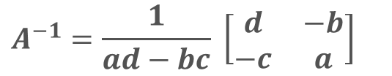
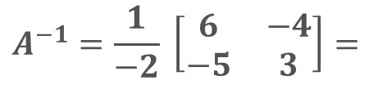

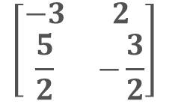
Teorema
Sea $A=\left[\begin{matrix}a & b \\ c & d\end{matrix}\right]$. Si $ad−bc≠0,$ entonces $A$ es invertible y
$$A^{−1}=\frac{1}{ad−bc} \left[\begin{matrix}d & −b \\ −c & a\end{matrix}\right]$$
Si $ad−bc=0,$ entonces $A$ no es invertible.
Ejemplo.
Encuentre la inversa de $A=\left[\begin{matrix}3 & 4 \\ 5 & 6\end{matrix}\right]$
Solución.
Dado que $det A=18−20=−2≠0,$ entonces $A$ es invertible
$$\left[\begin{matrix}\frac{6}{−2} & \frac{−4}{−2} \\ \frac{−5}{−2} & \frac{3}{−2}\end{matrix}\right]=$$
$$A^{−1}=\frac{1}{−2} \left[\begin{matrix}6 & −4 \\ −5 & 3\end{matrix}\right]=$$
$$\left[\begin{matrix}−3 & 2 \\ \frac{5}{2} & −\frac{3}{2}\end{matrix}\right]$$

Slide 7


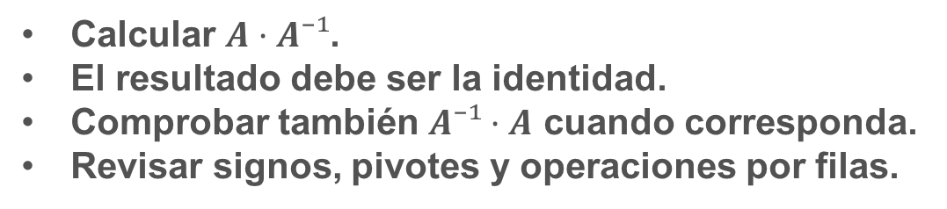
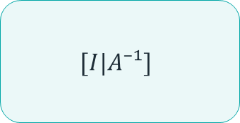
Gauss - Jordan
Ruta para obtener $A⁻¹$
Construir $[A|I]$
Pivotes
Ceros en fila/columna
$$[I|A⁻¹]$$
Verificación
No basta con obtener una matriz
Calcular $A·A⁻¹$.
El resultado debe ser la identidad.
Comprobar también $A⁻¹·A$ cuando corresponda.
Revisar signos, pivotes y operaciones por filas.

Slide 8


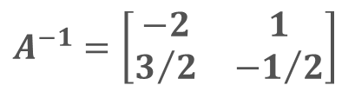
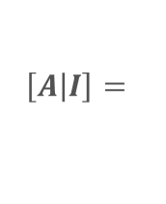
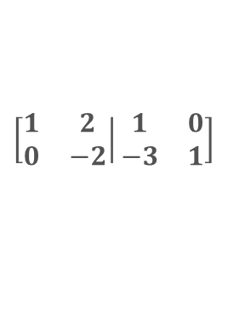
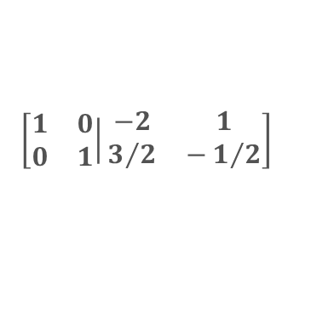



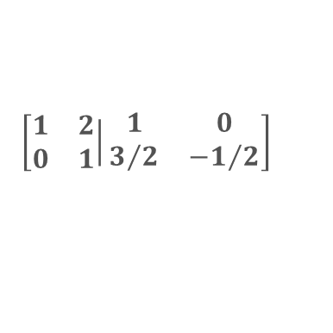
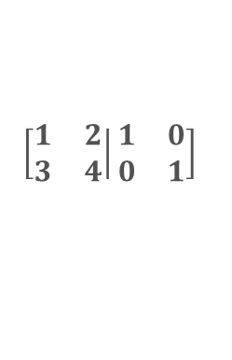

Ejemplo 1.
Encuentre la inversa de la matriz
$$A=\left[\begin{matrix}1 & 2 \\ 3 & 4\end{matrix}\right],$$
si acaso existe.
Solución.
$$\left[\left.\begin{matrix}1 & 2 \\ 3 & 4\end{matrix}\right|\begin{matrix}1 & 0 \\ 0 & 1\end{matrix}\right]$$
$$f_{2}→−3f_{1}+f_{2}$$
$$\left[\left.\begin{matrix}1 & 2 \\ 0 & −2\end{matrix}\right|\begin{matrix}1 & 0 \\ −3 & 1\end{matrix}\right]$$
$$f_{2}→−\frac{1}{2}f_{1}$$
$$\left[\left.\begin{matrix}1 & 2 \\ 0 & 1\end{matrix}\right|\begin{matrix}1 & 0 \\ 3/2 & {−1}/2\end{matrix}\right]$$
$$\left[\left.A\right|I\right]=$$
$$\left[\left.\begin{matrix}1 & 2 \\ 0 & 1\end{matrix}\right|\begin{matrix}1 & 0 \\ 3/2 & {−1}/2\end{matrix}\right]$$
$$f_{1}→−2f_{2}+f_{1}$$
$$\left[\left.\begin{matrix}1 & 0 \\ 0 & 1\end{matrix}\right|\begin{matrix}−2 & 1 \\ 3/2 & −1/2\end{matrix}\right]$$
Por tanto, matriz inversa es
$$A^{−1}=\left[\begin{matrix}−2 & 1 \\ 3/2 & {−1}/2\end{matrix}\right]$$

Slide 9
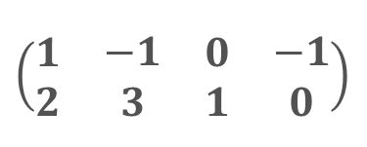
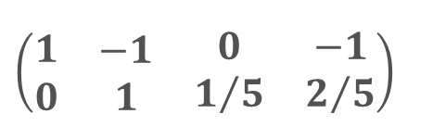
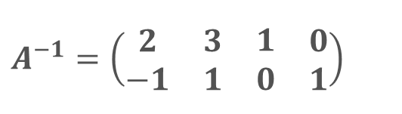

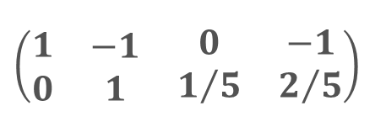
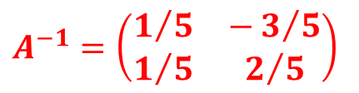



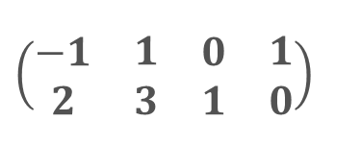
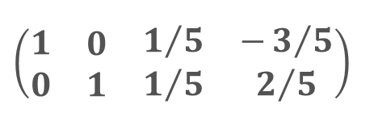
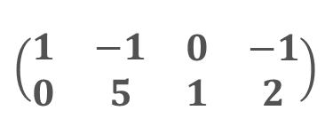



Ejemplo 2.
Encuentre la inversa de la matriz
$$A=\left(\begin{matrix}2 & 3 \\ −1 & 1\end{matrix}\right),$$
si acaso existe.
Solución.
$$A^{−1}=\left(\begin{matrix}\begin{aligned}2 \\ −1\end{aligned} & \begin{matrix}\begin{aligned}3 \\ 1\end{aligned} & \begin{matrix}\begin{aligned}1 \\ 0\end{aligned} & \begin{aligned}0 \\ 1\end{aligned}\end{matrix}\end{matrix}\end{matrix}\right)$$
$$\left(\begin{matrix}\begin{aligned}−1 \\ 2\end{aligned} & \begin{matrix}\begin{aligned}1 \\ 3\end{aligned} & \begin{matrix}\begin{aligned}0 \\ 1\end{aligned} & \begin{aligned}1 \\ 0\end{aligned}\end{matrix}\end{matrix}\end{matrix}\right)$$
$$\left(\begin{matrix}\begin{aligned}1 \\ 2\end{aligned} & \begin{matrix}\begin{aligned}−1 \\ 3\end{aligned} & \begin{matrix}\begin{aligned}0 \\ 1\end{aligned} & \begin{aligned}−1 \\ 0\end{aligned}\end{matrix}\end{matrix}\end{matrix}\right)$$
$$F_{1}↔F_{2}$$
$${F_{1}→−1F}_{1}$$
$$\left(\begin{matrix}\begin{aligned}1 \\ 2\end{aligned} & \begin{matrix}\begin{aligned}−1 \\ 3\end{aligned} & \begin{matrix}\begin{aligned}0 \\ 1\end{aligned} & \begin{aligned}−1 \\ 0\end{aligned}\end{matrix}\end{matrix}\end{matrix}\right)$$
$${F_{2}→−2F}_{1}+F_{2}$$
$$\left(\begin{matrix}\begin{aligned}1 \\ 0\end{aligned} & \begin{matrix}\begin{aligned}−1 \\ 5\end{aligned} & \begin{matrix}\begin{aligned}0 \\ 1\end{aligned} & \begin{aligned}−1 \\ 2\end{aligned}\end{matrix}\end{matrix}\end{matrix}\right)$$
$${F_{2}→\frac{1}{5}F}_{2}$$
$$\left(\begin{matrix}\begin{aligned}1 \\ 0\end{aligned} & \begin{matrix}\begin{aligned}−1 \\ 1\end{aligned} & \begin{matrix}\begin{aligned}0 \\ 1/5\end{aligned} & \begin{aligned}−1 \\ 2/5\end{aligned}\end{matrix}\end{matrix}\end{matrix}\right)$$
$$\left(\begin{matrix}\begin{aligned}1 \\ 0\end{aligned} & \begin{matrix}\begin{aligned}−1 \\ 1\end{aligned} & \begin{matrix}\begin{aligned}0 \\ 1/5\end{aligned} & \begin{aligned}−1 \\ 2/5\end{aligned}\end{matrix}\end{matrix}\end{matrix}\right)$$
$${F_{1}→1F}_{2}+F_{1}$$
$$\left(\begin{matrix}\begin{aligned}1 \\ 0\end{aligned} & \begin{matrix}\begin{aligned}0 \\ 1\end{aligned} & \begin{matrix}\begin{aligned}1/5 \\ 1/5\end{aligned} & \begin{aligned}−3/5 \\ 2/5\end{aligned}\end{matrix}\end{matrix}\end{matrix}\right)$$
$$A^{−1}=\left(\begin{matrix}1/5 & −3/5 \\ 1/5 & 2/5\end{matrix}\right)$$

Slide 10

Una matriz $A$ de $nxn$ es invertible si y solo si $A$ es equivalente por filas a $I_{n}$, y, en este caso, cualquier secuencia de operaciones elementales de fila que reduzca $A$ a $I_{n}$ también transforma a $I_{n}$ en $A^{−1}.$
Algoritmo para determinar $A^{−1}$
Reduzca por filas la matriz aumentada $\left[A I\right]$. Si $A$ es equivalente por filas a $I$, entonces $\left[A I\right]$ es equivalente por filas a $\left[I A^{−1}\right]$. De otra manera, $A$ no tiene inversa.

Slide 11



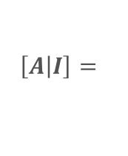
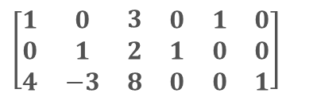
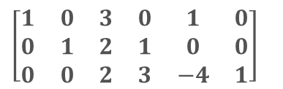
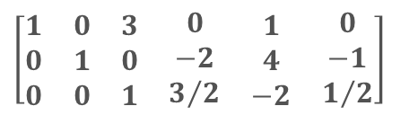
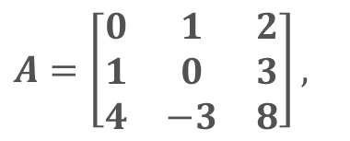



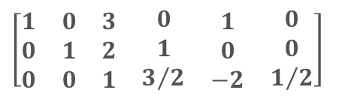
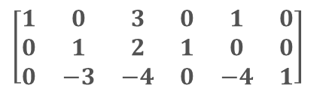
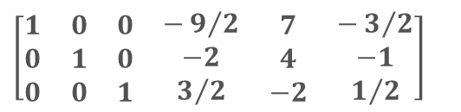
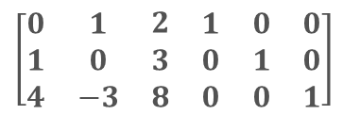
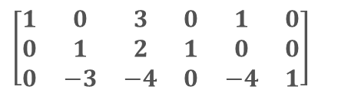
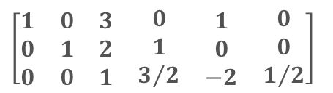
Ejemplo 1.
$$A=\left[\begin{matrix}0 & 1 & 2 \\ 1 & 0 & 3 \\ 4 & −3 & 8\end{matrix}\right],$$
Encuentre la inversa de la matriz
si acaso existe.
Solución.
$$\left[\begin{matrix}\begin{aligned}0 \\ 1 \\ 4\end{aligned} & \begin{matrix}\begin{aligned}1 \\ 0 \\ −3\end{aligned} & \begin{matrix}\begin{aligned}2 \\ 3 \\ 8\end{aligned} & \begin{matrix}\begin{aligned}1 \\ 0 \\ 0\end{aligned} & \begin{matrix}\begin{aligned}0 \\ 1 \\ 0\end{aligned} & \begin{aligned}0 \\ 0 \\ 1\end{aligned}\end{matrix}\end{matrix}\end{matrix}\end{matrix}\end{matrix}\right]$$
$$f_{1}↔f_{2}$$
$$\left[\begin{matrix}\begin{aligned}1 \\ 0 \\ 4\end{aligned} & \begin{matrix}\begin{aligned}0 \\ 1 \\ −3\end{aligned} & \begin{matrix}\begin{aligned}3 \\ 2 \\ 8\end{aligned} & \begin{matrix}\begin{aligned}0 \\ 1 \\ 0\end{aligned} & \begin{matrix}\begin{aligned}1 \\ 0 \\ 0\end{aligned} & \begin{aligned}0 \\ 0 \\ 1\end{aligned}\end{matrix}\end{matrix}\end{matrix}\end{matrix}\end{matrix}\right]$$
$$f_{3}→−4f_{1}+f_{3}$$
$$\left[\begin{matrix}\begin{aligned}1 \\ 0 \\ 0\end{aligned} & \begin{matrix}\begin{aligned}0 \\ 1 \\ −3\end{aligned} & \begin{matrix}\begin{aligned}3 \\ 2 \\ −4\end{aligned} & \begin{matrix}\begin{aligned}0 \\ 1 \\ 0\end{aligned} & \begin{matrix}\begin{aligned}1 \\ 0 \\ −4\end{aligned} & \begin{aligned}0 \\ 0 \\ 1\end{aligned}\end{matrix}\end{matrix}\end{matrix}\end{matrix}\end{matrix}\right]$$
$$\left[\left.A\right|I\right]=$$
$$\left[\begin{matrix}\begin{aligned}1 \\ 0 \\ 0\end{aligned} & \begin{matrix}\begin{aligned}0 \\ 1 \\ −3\end{aligned} & \begin{matrix}\begin{aligned}3 \\ 2 \\ −4\end{aligned} & \begin{matrix}\begin{aligned}0 \\ 1 \\ 0\end{aligned} & \begin{matrix}\begin{aligned}1 \\ 0 \\ −4\end{aligned} & \begin{aligned}0 \\ 0 \\ 1\end{aligned}\end{matrix}\end{matrix}\end{matrix}\end{matrix}\end{matrix}\right]$$
$$f_{3}→3f_{2}+f_{3}$$
$$\left[\begin{matrix}\begin{aligned}1 \\ 0 \\ 0\end{aligned} & \begin{matrix}\begin{aligned}0 \\ 1 \\ 0\end{aligned} & \begin{matrix}\begin{aligned}3 \\ 2 \\ 2\end{aligned} & \begin{matrix}\begin{aligned}0 \\ 1 \\ 3\end{aligned} & \begin{matrix}\begin{aligned}1 \\ 0 \\ −4\end{aligned} & \begin{aligned}0 \\ 0 \\ 1\end{aligned}\end{matrix}\end{matrix}\end{matrix}\end{matrix}\end{matrix}\right]$$
$$f_{3}→\frac{1}{2}f_{3}$$
$$\left[\begin{matrix}\begin{aligned}1 \\ 0 \\ 0\end{aligned} & \begin{matrix}\begin{aligned}0 \\ 1 \\ 0\end{aligned} & \begin{matrix}\begin{aligned}3 \\ 2 \\ 1\end{aligned} & \begin{matrix}\begin{aligned}0 \\ 1 \\ 3/2\end{aligned} & \begin{matrix}\begin{aligned}1 \\ 0 \\ −2\end{aligned} & \begin{aligned}0 \\ 0 \\ 1/2\end{aligned}\end{matrix}\end{matrix}\end{matrix}\end{matrix}\end{matrix}\right]$$
$$\left[\begin{matrix}\begin{aligned}1 \\ 0 \\ 0\end{aligned} & \begin{matrix}\begin{aligned}0 \\ 1 \\ 0\end{aligned} & \begin{matrix}\begin{aligned}3 \\ 2 \\ 1\end{aligned} & \begin{matrix}\begin{aligned}0 \\ 1 \\ 3/2\end{aligned} & \begin{matrix}\begin{aligned}1 \\ 0 \\ −2\end{aligned} & \begin{aligned}0 \\ 0 \\ 1/2\end{aligned}\end{matrix}\end{matrix}\end{matrix}\end{matrix}\end{matrix}\right]$$
$$\left[\begin{matrix}\begin{aligned}1 \\ 0 \\ 0\end{aligned} & \begin{matrix}\begin{aligned}0 \\ 1 \\ 0\end{aligned} & \begin{matrix}\begin{aligned}3 \\ 0 \\ 1\end{aligned} & \begin{matrix}\begin{aligned}0 \\ −2 \\ 3/2\end{aligned} & \begin{matrix}\begin{aligned}1 \\ 4 \\ −2\end{aligned} & \begin{aligned}0 \\ −1 \\ 1/2\end{aligned}\end{matrix}\end{matrix}\end{matrix}\end{matrix}\end{matrix}\right]$$
$$\left[\begin{matrix}\begin{aligned}1 \\ 0 \\ 0\end{aligned} & \begin{matrix}\begin{aligned}0 \\ 1 \\ 0\end{aligned} & \begin{matrix}\begin{aligned}0 \\ 0 \\ 1\end{aligned} & \begin{matrix}\begin{aligned}−9/2 \\ −2 \\ 3/2\end{aligned} & \begin{matrix}\begin{aligned}7 \\ 4 \\ −2\end{aligned} & \begin{aligned}−3/2 \\ −1 \\ 1/2\end{aligned}\end{matrix}\end{matrix}\end{matrix}\end{matrix}\end{matrix}\right]$$
$$f_{2}→−2f_{3}+f_{2}$$
$$f_{1}→−3f_{3}+f_{1}$$

Slide 12
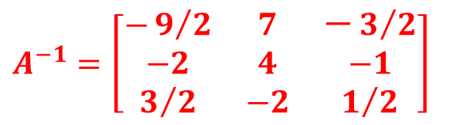
Por tanto, matriz inversa es
$$A^{−1}=\left[\begin{matrix}−9/2 & 7 & −3/2 \\ −2 & 4 & −1 \\ 3/2 & −2 & 1/2\end{matrix}\right]$$

Slide 13
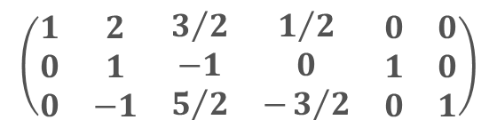

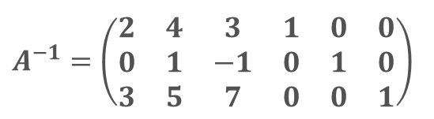

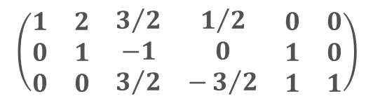
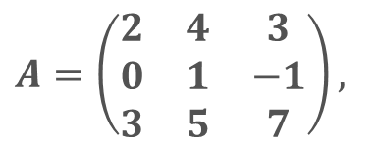
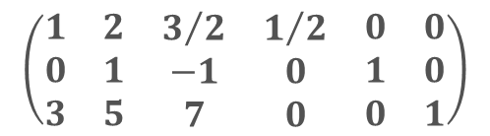
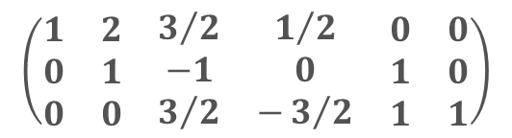



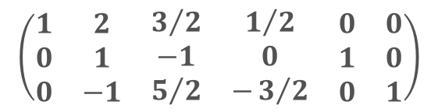
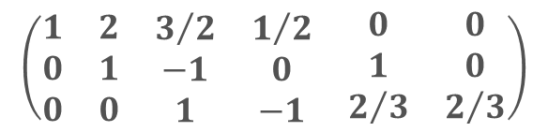
Ejemplo 2.
$$A=\left(\begin{matrix}2 & 4 & 3 \\ 0 & 1 & −1 \\ 3 & 5 & 7\end{matrix}\right),$$
Encuentre la inversa de la matriz
si acaso existe.
Solución.
$$A^{−1}=\left(\begin{matrix}\begin{aligned}2 \\ 0 \\ 3\end{aligned} & \begin{matrix}\begin{matrix}\begin{matrix}\begin{matrix}\begin{aligned}4 \\ 1 \\ 5\end{aligned} & \begin{aligned}3 \\ −1 \\ 7\end{aligned}\end{matrix} & \begin{aligned}1 \\ 0 \\ 0\end{aligned}\end{matrix} & \begin{aligned}0 \\ 1 \\ 0\end{aligned}\end{matrix} & \begin{aligned}0 \\ 0 \\ 1\end{aligned}\end{matrix}\end{matrix}\right)$$
$${\frac{1}{2}F}_{1}→F_{1}$$
$$\left(\begin{matrix}\begin{aligned}1 \\ 0 \\ 3\end{aligned} & \begin{matrix}\begin{matrix}\begin{matrix}\begin{matrix}\begin{aligned}2 \\ 1 \\ 5\end{aligned} & \begin{aligned}3/2 \\ −1 \\ 7\end{aligned}\end{matrix} & \begin{aligned}1/2 \\ 0 \\ 0\end{aligned}\end{matrix} & \begin{aligned}0 \\ 1 \\ 0\end{aligned}\end{matrix} & \begin{aligned}0 \\ 0 \\ 1\end{aligned}\end{matrix}\end{matrix}\right)$$
$$\left(\begin{matrix}\begin{aligned}1 \\ 0 \\ 3\end{aligned} & \begin{matrix}\begin{matrix}\begin{matrix}\begin{matrix}\begin{aligned}2 \\ 1 \\ 5\end{aligned} & \begin{aligned}3/2 \\ −1 \\ 7\end{aligned}\end{matrix} & \begin{aligned}1/2 \\ 0 \\ 0\end{aligned}\end{matrix} & \begin{aligned}0 \\ 1 \\ 0\end{aligned}\end{matrix} & \begin{aligned}0 \\ 0 \\ 1\end{aligned}\end{matrix}\end{matrix}\right)$$
$${−3F}_{1}+F_{3}→F_{3}$$
$$\left(\begin{matrix}\begin{aligned}1 \\ 0 \\ 0\end{aligned} & \begin{matrix}\begin{matrix}\begin{matrix}\begin{matrix}\begin{aligned}2 \\ 1 \\ −1\end{aligned} & \begin{aligned}3/2 \\ −1 \\ 5/2\end{aligned}\end{matrix} & \begin{aligned}1/2 \\ 0 \\ −3/2\end{aligned}\end{matrix} & \begin{aligned}0 \\ 1 \\ 0\end{aligned}\end{matrix} & \begin{aligned}0 \\ 0 \\ 1\end{aligned}\end{matrix}\end{matrix}\right)$$
$$\left(\begin{matrix}\begin{aligned}1 \\ 0 \\ 0\end{aligned} & \begin{matrix}\begin{matrix}\begin{matrix}\begin{matrix}\begin{aligned}2 \\ 1 \\ −1\end{aligned} & \begin{aligned}3/2 \\ −1 \\ 5/2\end{aligned}\end{matrix} & \begin{aligned}1/2 \\ 0 \\ −3/2\end{aligned}\end{matrix} & \begin{aligned}0 \\ 1 \\ 0\end{aligned}\end{matrix} & \begin{aligned}0 \\ 0 \\ 1\end{aligned}\end{matrix}\end{matrix}\right)$$
$$F_{2}+F_{3}→F_{3}$$
$$\left(\begin{matrix}\begin{aligned}1 \\ 0 \\ 0\end{aligned} & \begin{matrix}\begin{matrix}\begin{matrix}\begin{matrix}\begin{aligned}2 \\ 1 \\ 0\end{aligned} & \begin{aligned}3/2 \\ −1 \\ 3/2\end{aligned}\end{matrix} & \begin{aligned}1/2 \\ 0 \\ −3/2\end{aligned}\end{matrix} & \begin{aligned}0 \\ 1 \\ 1\end{aligned}\end{matrix} & \begin{aligned}0 \\ 0 \\ 1\end{aligned}\end{matrix}\end{matrix}\right)$$
$$\left(\begin{matrix}\begin{aligned}1 \\ 0 \\ 0\end{aligned} & \begin{matrix}\begin{matrix}\begin{matrix}\begin{matrix}\begin{aligned}2 \\ 1 \\ 0\end{aligned} & \begin{aligned}3/2 \\ −1 \\ 3/2\end{aligned}\end{matrix} & \begin{aligned}1/2 \\ 0 \\ −3/2\end{aligned}\end{matrix} & \begin{aligned}0 \\ 1 \\ 1\end{aligned}\end{matrix} & \begin{aligned}0 \\ 0 \\ 1\end{aligned}\end{matrix}\end{matrix}\right)$$
$${\frac{2}{3}F}_{3}→F_{3}$$
$$\left(\begin{matrix}\begin{aligned}1 \\ 0 \\ 0\end{aligned} & \begin{matrix}\begin{matrix}\begin{matrix}\begin{matrix}\begin{aligned}2 \\ 1 \\ 0\end{aligned} & \begin{aligned}3/2 \\ −1 \\ 1\end{aligned}\end{matrix} & \begin{aligned}1/2 \\ 0 \\ −1\end{aligned}\end{matrix} & \begin{aligned}0 \\ 1 \\ 2/3\end{aligned}\end{matrix} & \begin{aligned}0 \\ 0 \\ 2/3\end{aligned}\end{matrix}\end{matrix}\right)$$

Slide 14
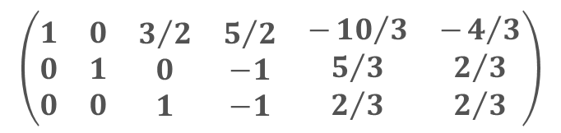

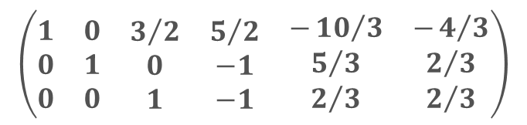


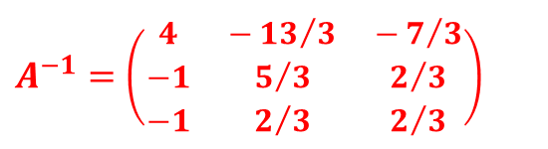
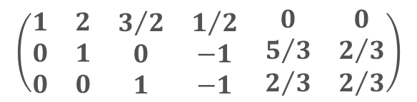
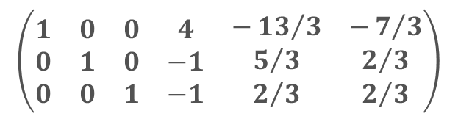


$$\left(\begin{matrix}\begin{aligned}1 \\ 0 \\ 0\end{aligned} & \begin{matrix}\begin{matrix}\begin{matrix}\begin{matrix}\begin{aligned}2 \\ 1 \\ 0\end{aligned} & \begin{aligned}3/2 \\ −1 \\ 1\end{aligned}\end{matrix} & \begin{aligned}1/2 \\ 0 \\ −1\end{aligned}\end{matrix} & \begin{aligned}0 \\ 1 \\ 2/3\end{aligned}\end{matrix} & \begin{aligned}0 \\ 0 \\ 2/3\end{aligned}\end{matrix}\end{matrix}\right)$$
$$F_{3}+F_{2}→F_{2}$$
$$\left(\begin{matrix}\begin{aligned}1 \\ 0 \\ 0\end{aligned} & \begin{matrix}\begin{matrix}\begin{matrix}\begin{matrix}\begin{aligned}2 \\ 1 \\ 0\end{aligned} & \begin{aligned}3/2 \\ 0 \\ 1\end{aligned}\end{matrix} & \begin{aligned}1/2 \\ −1 \\ −1\end{aligned}\end{matrix} & \begin{aligned}0 \\ 5/3 \\ 2/3\end{aligned}\end{matrix} & \begin{aligned}0 \\ 2/3 \\ 2/3\end{aligned}\end{matrix}\end{matrix}\right)$$
$$\left(\begin{matrix}\begin{aligned}1 \\ 0 \\ 0\end{aligned} & \begin{matrix}\begin{matrix}\begin{matrix}\begin{matrix}\begin{aligned}2 \\ 1 \\ 0\end{aligned} & \begin{aligned}3/2 \\ 0 \\ 1\end{aligned}\end{matrix} & \begin{aligned}1/2 \\ −1 \\ −1\end{aligned}\end{matrix} & \begin{aligned}0 \\ 5/3 \\ 2/3\end{aligned}\end{matrix} & \begin{aligned}0 \\ 2/3 \\ 2/3\end{aligned}\end{matrix}\end{matrix}\right)$$
$${−2F}_{2}+F_{1}→F_{1}$$
$$\left(\begin{matrix}\begin{aligned}1 \\ 0 \\ 0\end{aligned} & \begin{matrix}\begin{matrix}\begin{matrix}\begin{matrix}\begin{aligned}0 \\ 1 \\ 0\end{aligned} & \begin{aligned}3/2 \\ 0 \\ 1\end{aligned}\end{matrix} & \begin{aligned}5/2 \\ −1 \\ −1\end{aligned}\end{matrix} & \begin{aligned}−{10}/3 \\ 5/3 \\ 2/3\end{aligned}\end{matrix} & \begin{aligned}−4/3 \\ 2/3 \\ 2/3\end{aligned}\end{matrix}\end{matrix}\right)$$
$$\left(\begin{matrix}\begin{aligned}1 \\ 0 \\ 0\end{aligned} & \begin{matrix}\begin{matrix}\begin{matrix}\begin{matrix}\begin{aligned}0 \\ 1 \\ 0\end{aligned} & \begin{aligned}3/2 \\ 0 \\ 1\end{aligned}\end{matrix} & \begin{aligned}5/2 \\ −1 \\ −1\end{aligned}\end{matrix} & \begin{aligned}−{10}/3 \\ 5/3 \\ 2/3\end{aligned}\end{matrix} & \begin{aligned}−4/3 \\ 2/3 \\ 2/3\end{aligned}\end{matrix}\end{matrix}\right)$$
$${−\frac{3}{2}F}_{3}+F_{1}→F_{1}$$
$$\left(\begin{matrix}\begin{aligned}1 \\ 0 \\ 0\end{aligned} & \begin{matrix}\begin{matrix}\begin{matrix}\begin{matrix}\begin{aligned}0 \\ 1 \\ 0\end{aligned} & \begin{aligned}0 \\ 0 \\ 1\end{aligned}\end{matrix} & \begin{aligned}4 \\ −1 \\ −1\end{aligned}\end{matrix} & \begin{aligned}−{13}/3 \\ 5/3 \\ 2/3\end{aligned}\end{matrix} & \begin{aligned}−7/3 \\ 2/3 \\ 2/3\end{aligned}\end{matrix}\end{matrix}\right)$$
$$A^{−1}=\left(\begin{matrix}4 & −{13}/3 & −7/3 \\ −1 & 5/3 & 2/3 \\ −1 & 2/3 & 2/3\end{matrix}\right)$$

Slide 15





Teorema
Si $A$ es una matriz invertible de $nxn$, entonces, para cada $b$ en $ℝ^{n},$ la ecuación $Ax=b$ tiene la solución única $x=A^{−1}b$
Ejemplo.
Resuelva el sistema
$$3x_{1}+4x_{2}=3$$
$$5x_{1}+6x_{2}=7$$
Solución.
Este sistema es equivalente a $Ax=b,$ por lo que
$$\left[\begin{matrix}−3 & 2 \\ \frac{5}{2} & −\frac{3}{2}\end{matrix}\right]\left[\begin{matrix}3 \\ 7\end{matrix}\right]=$$
$$x=A^{−1}b=$$
$$\left[\begin{matrix}5 \\ −3\end{matrix}\right]$$

Slide 16
Teorema (Incluir a su Calculadora)
a) Si $A$ es una matriz invertible, entonces $A^{−1}$ es invertible y ${\left(A^{−1}\right)}^{−1}=A$
b) Si $A$ y $B$ son matrices invertibles de $nxn$, entonces también lo es $AB$ y la inversa de $AB$ es el producto de las inversas de $A$ y $B$ en el orden opuesto. Es decir, ${\left(AB\right)}^{−1}=B^{−1}A^{−1}$
c) Si $A$ es una matriz invertible, también lo es $A^{T}$, y la inversa de $A^{T}$ es la transpuesta de $A^{−1}.$Es decir, ${\left(A^{T}\right)}^{−1}={\left(A^{−1}\right)}^{T}$

Slide 17


Caracterizaciones de matrices invertibles
El teorema de la matriz invertible (Incluir a su Calculadora las que tienen asterisco)
Sea $A$ una matriz cuadrada de $nxn$. Entonces los siguientes enunciados son equivalentes. Es decir, para una $A$ dada, los enunciados son todos ciertos o todos falsos.
a) $A$ es una matriz invertible.
b) $A$ es equivalente por filas a la matriz identidad de $nxn$.
*c) $A$ tiene $n$ posiciones pivote.
d) La ecuación $Ax=0$ tiene solamente la solución trivial.
*e) Las columnas de $A$ forman un conjunto linealmente independientes.
f) La transformación lineal $x↦Ax$ es uno a uno.
g) La ecuación $Ax=b$ tiene al menos una solución para toda $b$ en $ℝ^{n}$

Slide 18


Caracterizaciones de matrices invertibles (Continuación)
*h) Las columnas de $A$ generan $ℝ^{n}$
i) La transformación lineal $x↦Ax$ mapea $ℝ^{n}$ sobre $ℝ^{n}$.
j) Existe una matriz $C$de $nxn$ tal que $CA=I$
k) Existe una matriz $D$ de $nxn$ tal que $AD=I$
l) $A^{T}$ es una matriz invertible.

Slide 19








Ejemplo.
Use el teorema de la matriz invertible para determinar si $A$ es invertible:
$$A=\left[\begin{matrix}1 & 0 & −2 \\ 3 & 1 & −2 \\ −5 & −1 & 9\end{matrix}\right]$$
Solución.
$$\left[\begin{matrix}1 & 0 & −2 \\ 3 & 1 & −2 \\ −5 & −1 & 9\end{matrix}\right]$$
$$f_{2}→{−3f}_{1}+f_{2}$$
$$\left[\begin{matrix}1 & 0 & −2 \\ 0 & 1 & 4 \\ −5 & −1 & 9\end{matrix}\right]$$
$$f_{3}→{5f}_{1}+f_{3}$$
$$\left[\begin{matrix}1 & 0 & −2 \\ 0 & 1 & 4 \\ 0 & −1 & −1\end{matrix}\right]$$
$$f_{3}→f_{2}+f_{3}$$
$$\left[\begin{matrix}1 & 0 & −2 \\ 0 & 1 & 4 \\ 0 & 0 & 3\end{matrix}\right]$$
Por lo que $A$ tiene tres posiciones pivote y, por tanto, es invertible, de acuerdo con el enunciado c) de teorema de la matriz invertible.

Slide 20


Actividad: Problema de practica
$A=\left[\begin{matrix}1 & −2 & −1 \\ −1 & 5 & 6 \\ 5 & −4 & 5\end{matrix}\right]$, si acaso existe
1. Escriba un programa para encontrar la inversa de la matriz
2. Determine si $A=\left[\begin{matrix}2 & 3 & 4 \\ 2 & 3 & 4 \\ 2 & 3 & 4\end{matrix}\right]$ es invertible
3. Suponga que para cierta matriz $A$ de $nxn$, el enunciado $g)$ del teorema de la matriz invertible no es verdadero. ¿Qué puede decirse acerca de las ecuaciones de la forma $Ax=b$?
4. Suponga que $A$ y $B$ son matrices de $nxn$ y que la ecuación $ABx=0$ tiene una solución no trivial. ¿Qué puede decirse acerca de la matriz $AB$?

Slide 21
REFERENCIAS BIBLIOGRÁFICAS
Textos Obligatorio
Grossman, S., & Flores Godoy, J. (2019). Álgebra lineal (8.ª ed.). McGraw-Hill.
Lay, D. C. (2012). Álgebra lineal y sus aplicaciones (4.ª ed.). Pearson Educación.
Textos Optativos
Chapra, S. C., & Canale, R. P. (2015). Métodos numéricos para ingenieros (7.ª ed.). McGraw-Hill.
Poole, D. (2011). Álgebra lineal: Una introducción moderna (3.ª ed.). Cengage Learning.

